Slide 1
CMP203 Graphics Programming
Stencil buffer

Slide 2
This week
Stencil buffer
What is it
How does it work
Using the stencil buffer
“reflection”

Slide 3
Stencil buffer
Yet another buffer
A stencil buffer contains one or more stencil bits per pixel and is heavily aligned with the frame buffer
The contents of the stencil buffer can’t be seen directly
but we can control the values in the stencil buffer
Done by rendering to the stencil buffer
The stencil test in the fragment operations can decide whether the corresponding pixel colour values are updated

Slide 4

Stencil buffer
Allows us to restrict drawing to certain areas of the screen
Like a cardboard stencil and a spray can
An application can control what happens under three different scenarios
The stencil test fails
The stencil test passes, but the depth test fails
Both the stencil and the depth test pass
Stencil testing occurs immediately after alpha tests

Slide 5
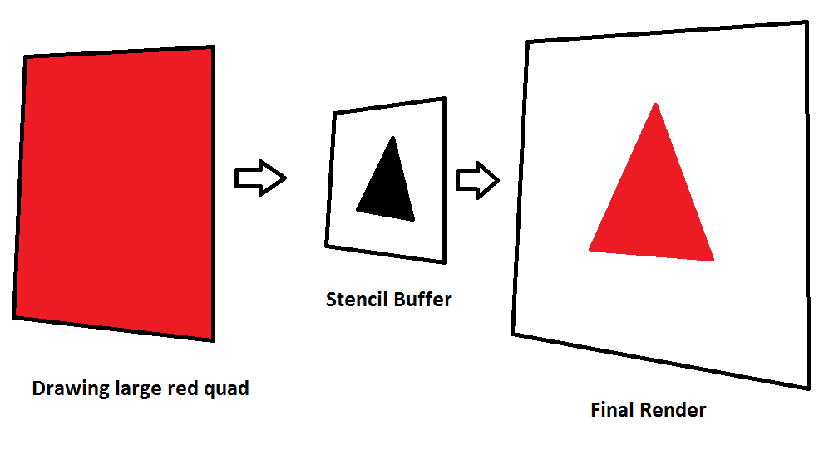
How

Slide 6
What for?
Used for a number of effects
Reflections/mirrors
Shadows
Outline drawing / highlighting
Portals
Etc
Most commonly used for planar reflections
Requires multiple render passes
Resource intensive

Slide 7
What for?
An example
Rendering the scene through an odd shaped windscreen (driving game)
We store the shape of the windscreen in the stencil buffer
When drawing the whole scene we test against the stencil buffer
Only renders objects visible through the windscreen
Can separate the drawing the of the inside and outside of the car

Slide 8
Important functions
glEnable(GL_STENCIL_TEST)
glStencilMask( mask )
glClearStencil( value )
glStencilFunc( func, ref, mask )
glStencilOp ( fail, zfail, zpass )
glClear(GL_STENCIL_BUFFER_BIT)

Slide 9
Important functions
glDisable/glEnable(GL_STENCIL_TEST)
Turn stencil test on and off
glStencilFunc(func, ref, mask)
Define stencil test parameters
Func is the test performed
GL_NEVER, GL_LESS, GL_LEQUAL, GL_EQUAL, GL_ALWAYS, etc
Reference value used in stencil comparison
Mask is combined with the current stencil value and reference value and stored in the stencil

Slide 10
Important functions
glStencilOp(f, zf, zp)
Defines outcome of stencil test
F - specifies what to do when the stencil test fails
Zf - if the stencil test passes but the depth test fails
Zp - if the stencil & depth test pass
For all we can decide to Keep or replace the current value
GL_KEEP or GL_REPLACE
glClear(GL_STENCIL_BUFFER_BIT)
Clear stencil buffer, just like colour and depth buffer

Slide 11
Important functions
glStencilMask( n );
Enables and disables writing in the stencil
Initially the mask is all 1’s
If 1 it’s possible to write in the stencil buffer
If 0 it is write protected
glClearStencil ( 0 )
Specifies the value to be used when clearly the stencil buffer
When glClear(GL_STENCIL_BUFFER_BIT) is called
Default is 0

Slide 12
Important functions
glColorMask ( r, g, b, a)
Not specific to stencil buffer
But used in conjunction
Can enable and disable rendering to the frame buffer
Of individual or all colours

Slide 13
Examples
As mentioned a common use of the stencil buffer is planar reflections
What
How
Multi pass rendering
Code

Slide 14
Reflection
Concept
“Common” effect in games
Used to simulate materials with an extremely high specular value
Used to be considered a very ‘special’ effect
Must be treated with care as it is still very computationally expensive

Slide 15
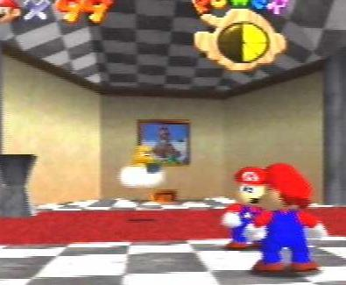
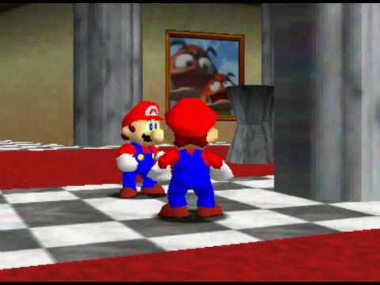
Reflection in games

Slide 16
Reflection
Advantages / Disadvantages
Requires all geometry reflected in mirror to be drawn twice!
Only good for near perfect specular reflections
‘Imposter’ Mirrors
No true reflections, simply render dummy objects on the other side of the mirror
Suited to games with a particular fixed view

Slide 17

Reflections at the movies

Slide 18
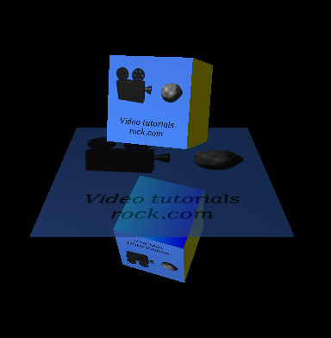
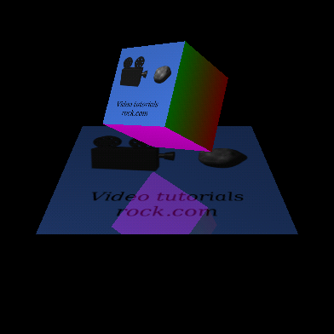
Reflection with stencil example

Slide 19
Multi pass rendering
A technique used to provide more control over the scene compared to single pass rendering
The final image is computed by rendering some or all of the objects in the scene multiple times
Providing control over the processing steps used in the pipeline
Most commonly used for lighting and other special effects
Compile the scene by rendering it multiple times
Once for each light (for example)
Post processing

Slide 20
Multi pass rendering
Disadvantages
You will need to give serious thought to the order you render your scene
Multiple passes requires more resources
Based on how much of your scene is being render multiple times
In the case of reflection
Reflect the close objects
Far away objects are a waste of resources

Slide 21
Example
A simple reflection
An object floating and rotating
A simple quad floor
The reflection of the object “in” the floor
Also rotating, to match the original object

Slide 22
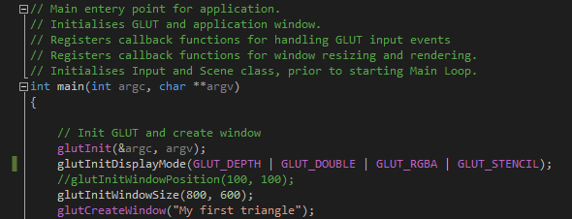
Example
Before drawing we need to setup the stencil buffer
Main.cpp in main()
glutInitDisplayMode(GLUT_DEPTH | GLUT_DOUBLE | GLUT_RGBA | GLUT_STENCIL);
Without it our stencil buffer is zero bytes

Slide 23
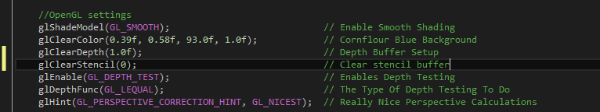
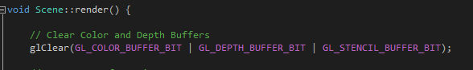
Example
Scene()
Addition openGL Settings
glClearStencil(0);
Setting how to clear the buffer
Render()
glClear(GL_COLOR_BUFFER_BIT | GL_DEPTH_BUFFER_BIT | GL_STENCIL_BUFFER_BIT);
Each frame must now clear the stencil buffer along with the colour and depth buffer

Slide 24
Example
Example pseudocode
Turn off writing to the frame buffer
glColorMask(GL_FALSE, GL_FALSE, GL_FALSE, GL_FALSE);
Enable the stencil test
glEnable(GL_STENCIL_TEST);
Set the stencil function to always pass
glStencilFunc(GL_ALWAYS, 1, 1);
Set the Stencil Operation to replace values when the test passes
glStencilOp(GL_KEEP, GL_KEEP, GL_REPLACE);

Slide 25
Example
Disable the depth test (we don’t want to store depths values while writing to the stencil buffer
glDisable(GL_DEPTH_TEST);
Draw floor object()
A simple 2 unit quad
Enable depth test
glEnable(GL_DEPTH_TEST);
Turn on rendering to the frame buffer
glColorMask(GL_TRUE, GL_TRUE, GL_TRUE, GL_TRUE);
Set stencil function to test if the value is 1
glStencilFunc(GL_EQUAL, 1, 1);
Set the stencil operation to keep all values (we don’t want to change the stencil)
glStencilOp(GL_KEEP, GL_KEEP, GL_KEEP);

Slide 26
Example
glPushMatrix();
Flip the scale vertically
glScalef(1.0, -1.0, 1.0);
Translate down (this will put us under the floor)
glTranslatef(0, 1, 0);
Rotate (the shape will be spinning)
glRotatef(angle, 0, 1, 0);
Render a model
glPopMatrix();
Disable stencil test (no longer needed)
glDisable(GL_STENCIL_TEST);
Enable alpha blending (to combine the floor object with model)
glEnable(GL_BLEND);

Slide 27
Example
Disable lighting (100% reflective object)
glDisable(GL_LIGHTING);
Set colour of floor object
glColor4f(0.8f, 0.8f, 1.0f, 0.8f);
Draw floor object
Enable lighting (rest of scene is lit correctly)
glEnable(GL_LIGHTING);
Disable blend (no longer blending)
glDisable(GL_BLEND);
glPushMatrix();
Translate (this is where the model will render, distance should match)
glTranslatef(0, 1, 0);
glRotatef(angle, 0, 1, 0);
Render the real object
model.Render();
glPopMatrix();

Slide 28
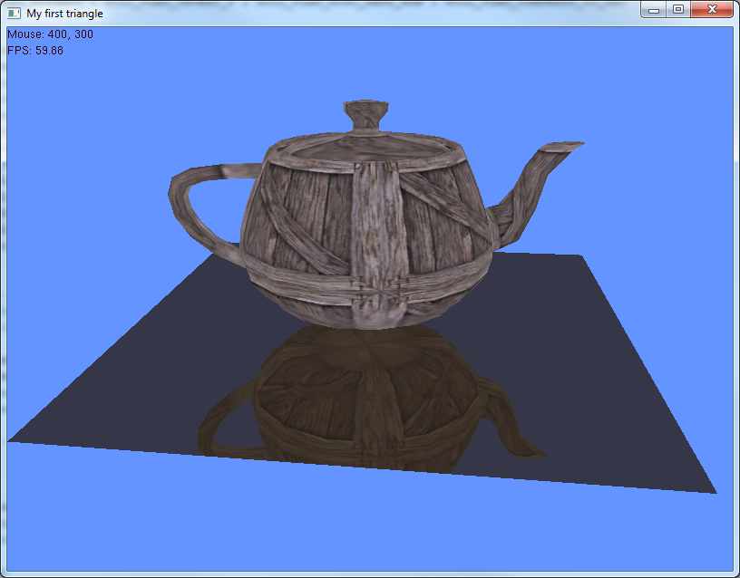

Slide 29
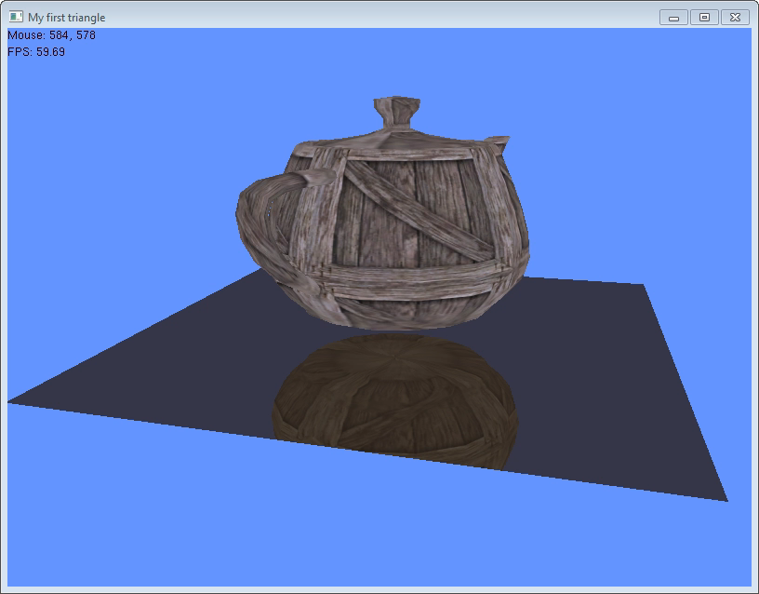
With Stencil test

Slide 30
Example
Our scene without the stencil buffer hard at work

Slide 31
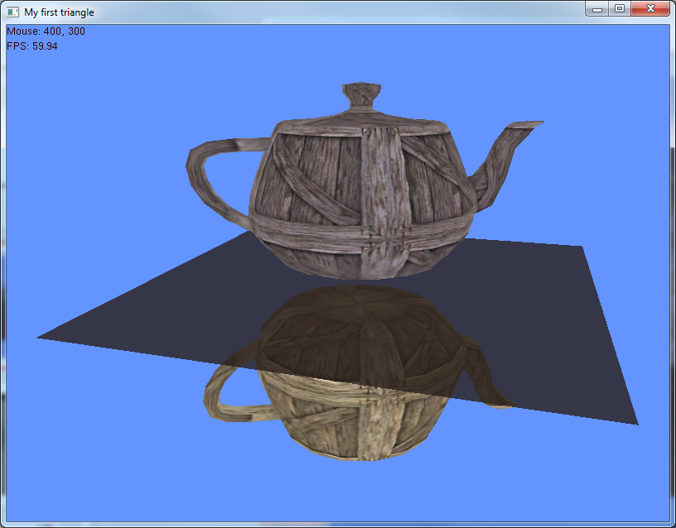

Slide 32
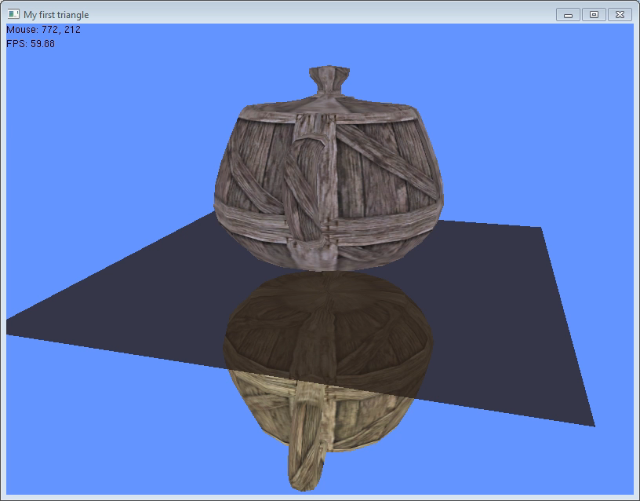
Without Stencil test

Slide 33
Summary
Labs
Building a reflective object
Additional reading
OpenGL Super Bible pg. 121
http://iu.edu.jo/files/FacultyIT/slides_it/ComputerGraphics/OpenGL%20SuperBible%204th%20Edition.pdf
Revision lecture, what would you like to cover
Email me
Blood donation here at Abertay Tuesday 29th November
I encourage you to donate
Can book a slot here: http://www.supersaas.com/schedule/Abertay-Estates/Blood_Transfusion_Service
Posters round the building with info

Slide 34
